Slide 1

March 19-23
2019 TAMIDS Data Science Competition
LOS ANGELES METRO
BIKE SHARE DATA ANALYSIS
Team Name – ENSEMBLE
Team Members: 1) Ayan Patel
2) Gaurav Burman
3) Prakhar Bajpai
4) Saksham Agrawal
Mentor- Dr. Rui Tuo

Slide 2
PROBLEM STATEMENT
Using the historical data of individual trips for past three years, we intend to identify ways of:
Projecting Bicycle demand in all three regions for Q1, 2019.
Identifying potential new station locations.
Making recommendations for possible pricing modifications.
Identifying key characteristics that identify whether a region will be successful in future by evaluating the four regions found in these data.

Slide 3
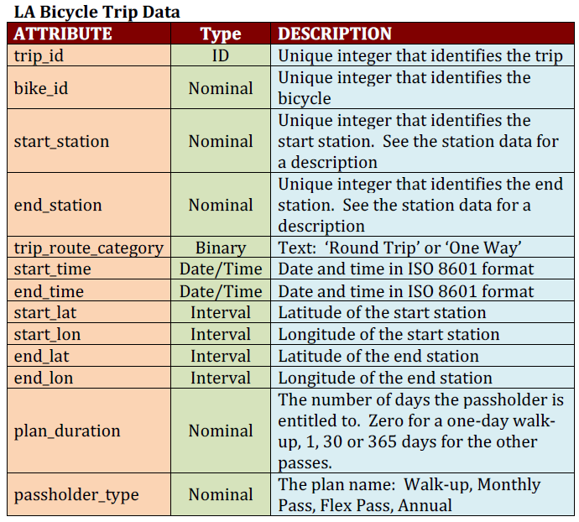
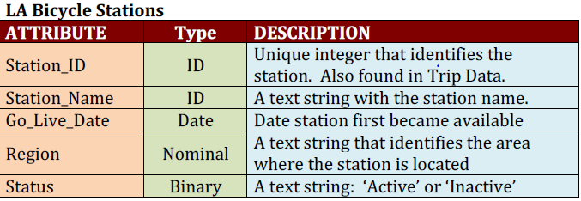
Data Summary
LAbike dataset : 639786 unique trip details with 13 attributes
Stations_Table dataset: Details pertaining to 143 bike stations distributed in 4 regions

Slide 4
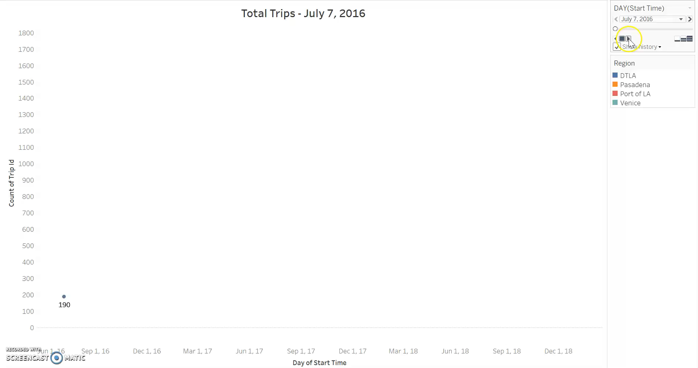
DATA EXPLORATION
Services in Downtown LA started in July 2016.
Currently, operating in three regions: Downtown LA, Port of LA and Venice.
Services terminated in Pasadena in August 2018 after running for a year.
A sudden spikes are seen on 4 days of CicLAvia festival.

Slide 5
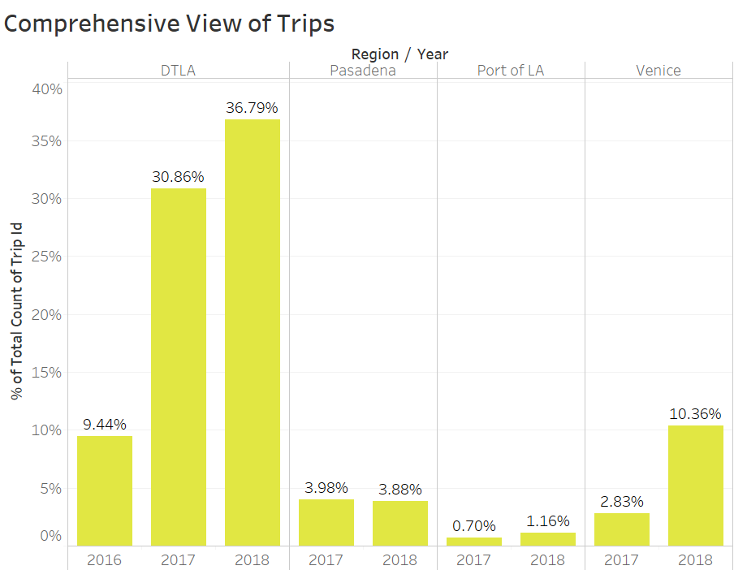
KEY CHARACTERSTICS OF REGIONS
Population Density (obtained from census data)
Employment Density (obtained from CTPP data)
Accessibility to other modes of transportation
Tourist places, Universities & Grocery stores.

Slide 6
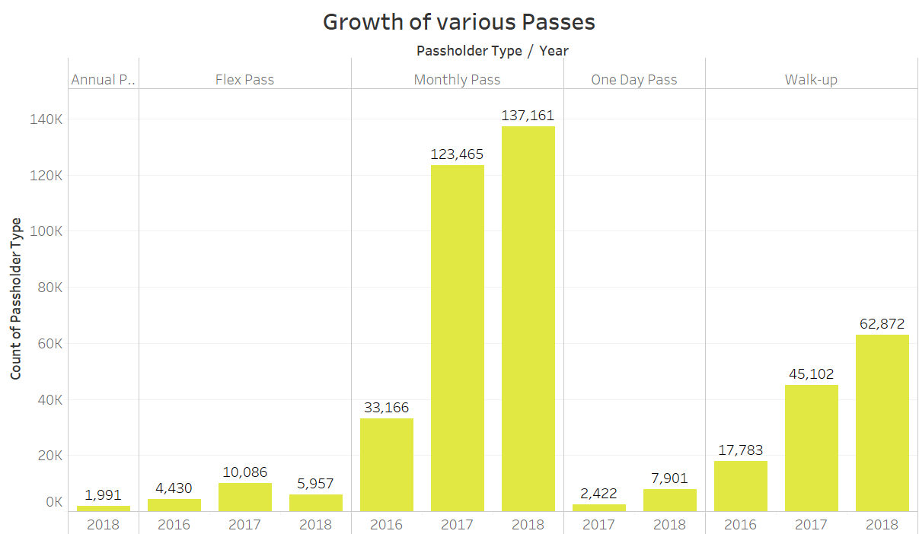
PASS TYPES
Monthly pass has shown significant growth in three years.
Distinct user details would have provided accurate revenue insights.
Walk up trips have also increased substantially.
Company revised the tariff of
each pass type in July 2018.
*Confirmed from here

Slide 7
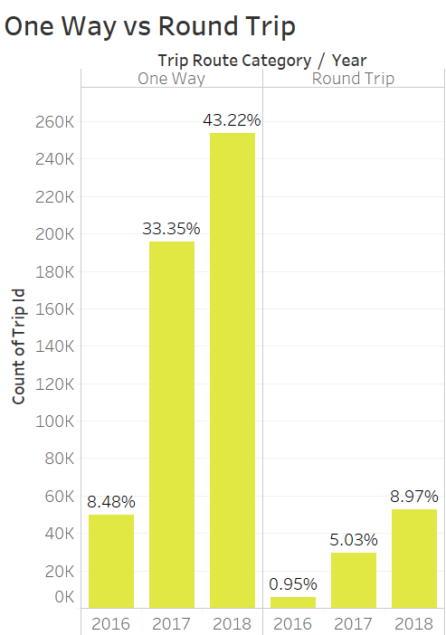
TRIP CATEGORY
Majority of trips were One-way.
Total trips have increased in both categories in each year.

Slide 8
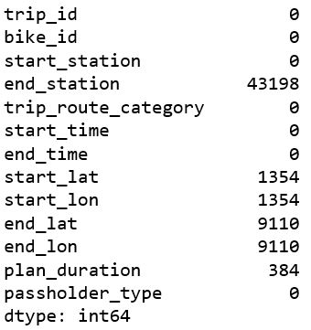
DATA CLEANING
Missing Values in LABikeData
Missing Values
No observations were removed to train the forecasting model.
Observations with missing values were removed for Price Modeling and Network Management.
Outliers
Zero Longitude and Latitude
Trip Durations beyond 24 hours
Virtual Stations

Slide 9
FEATURE ENGINEERING
Count- Number of Trips per day
Distance- Distance covered per trip in miles
Duration- Time taken in each trip in minutes

Slide 10
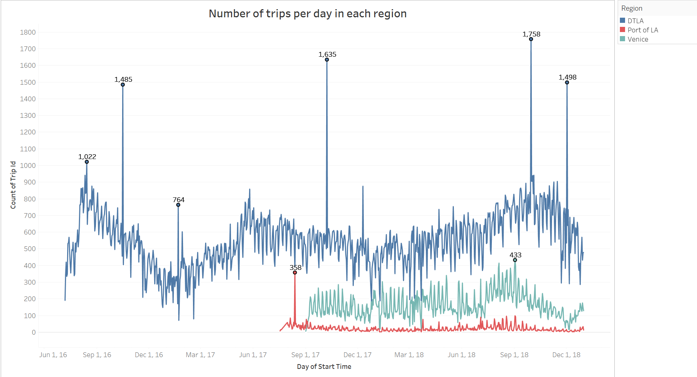
FORECASTING BICYCLE DEMAND
Generated Time Series data for count of trips per day for all three regions.
Forecasted the number of trips for Q1, 2019 using ARIMA algorithm.
ARIMA takes into consideration both Seasonality and Trend.
Daily Trips/bike ratio were calculated for ACTUAL ridership in each region.
Inter-region transfer of bikes and including bikes in idle state skewed this ratio for Quarterly analysis.
Region | (Trips/Bike) per day | (Trips/Bike) per quarter
DTLA | 1.83 | 56.56
Port of LA | 1.4 | 11.14
Venice | 2.23 | 68.33

Slide 11
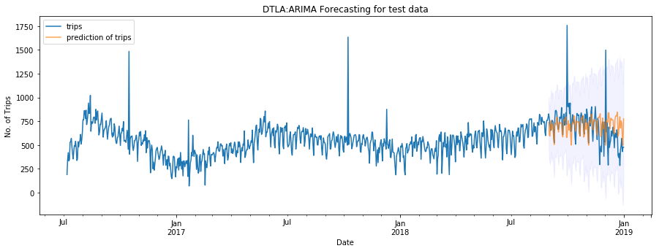
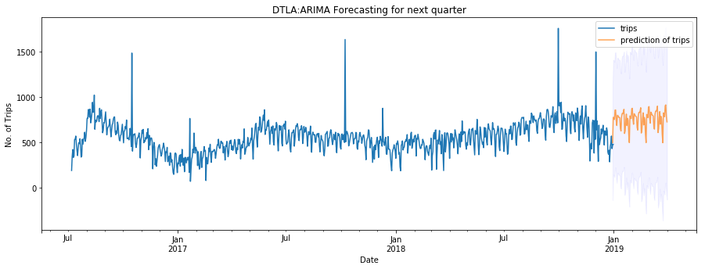
DOWNTOWN LA
Training Data:
1st July 2016 – 31st Aug 2018
Test Data:
1st Sep 2018- 31st Dec 2018
Fitted ARIMA(1,0,1)(1,2,2)7 on training data.
Validated model on test data with accuracy of 80%.
Predicted trips for Q1 2019.

Slide 12
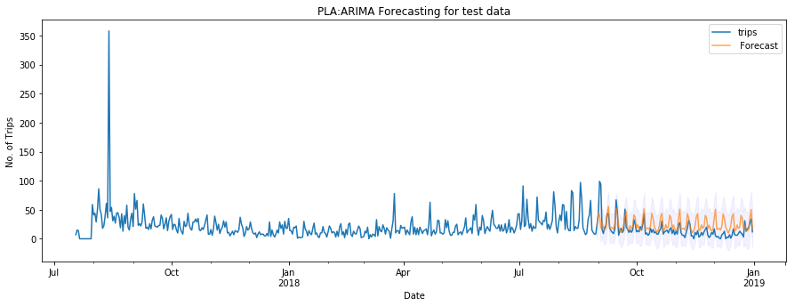
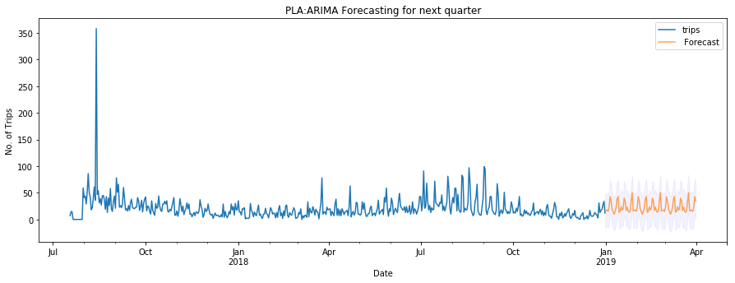
PORT OF LA
Training Data:
31st July 2017 – 31st Aug 2018
Test Data:
1st Sep 2018- 31st Dec 2018
Fitted ARIMA(1,0,1)(1,1,2)7 on training data.
Validated model on test data with accuracy of 45.50%
Predicted trips for Q1 2019

Slide 13
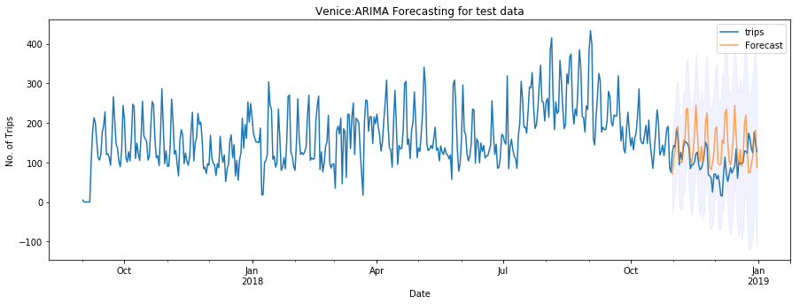
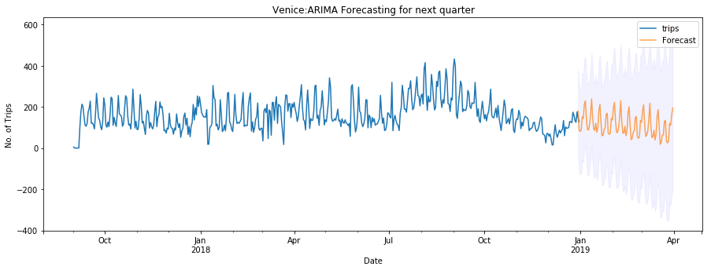
VENICE
Training Data:
1st Sep 2017 – 31st Sep 2018
Test Data:
1st Oct 2018- 31st Dec 2018
Fitted ARIMA(0,1,2)(1,2,2)7 on training data.
Validated model on test data with accuracy of 44%.
Predicted trips for Q1 2019.

Slide 14
PROJECTION OF BIKE DEMAND
QUARTER 1 2019 PROJECTIONS
Region | Trips predicted using ARIMA | Bike Requirement as per daily ratio | Bike Requirement as per current trend
DTLA | 68398 | 415 | 1209
VENICE | 11567 | 58 | 169
Port of LA | 2020 | 16 | 181

Slide 15
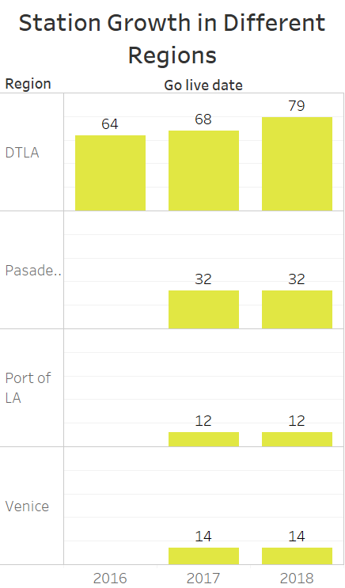
NETWORK MANAGEMENT
Identified popular stations and routes.
Popularity of routes measured by count of trips between 2 stations.
Selected top 45 routes out of total 6372 routes which cover 15% of total one-way trips.

Slide 16
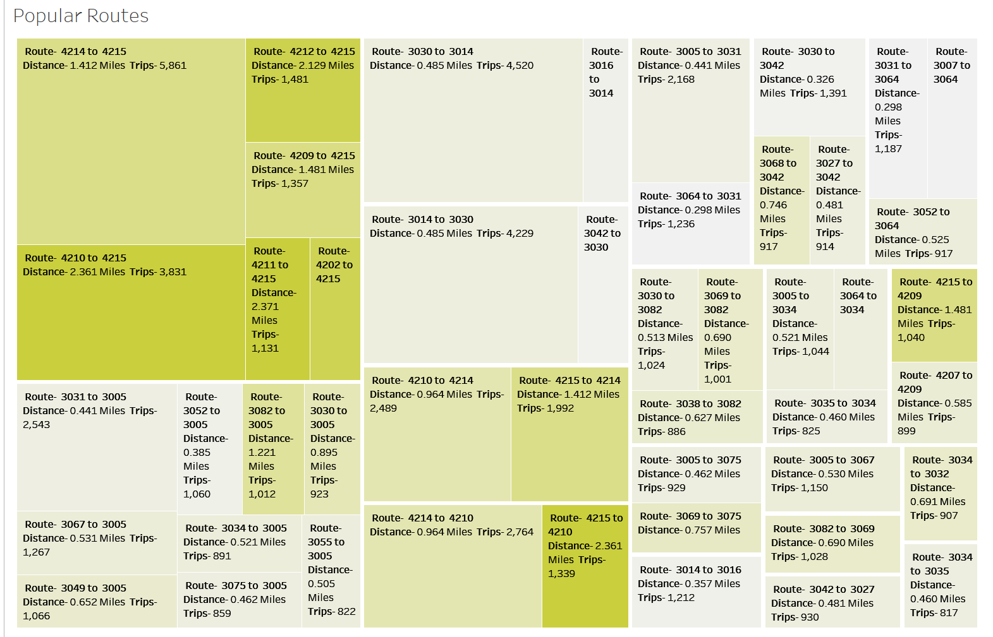
NETWORK MANAGEMENT
Color intensity represents distance between stations
Size of the block represents number of trips between the stations
Intersection of maximum number of trips and maximum distance calculated. Routes identified for potential new stations
Density of user population at different Stations

Slide 17
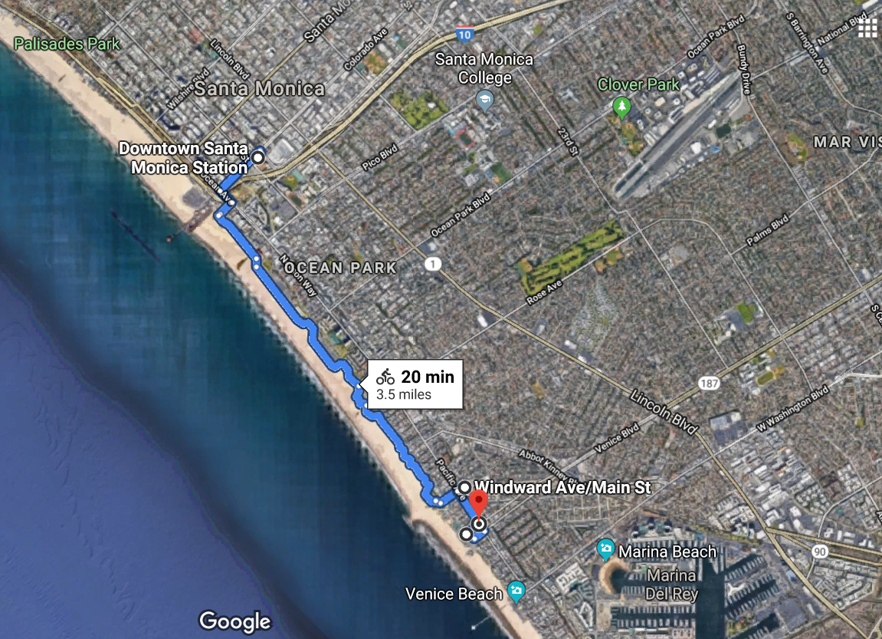
GEOGRAPHICAL VIEW

Slide 18
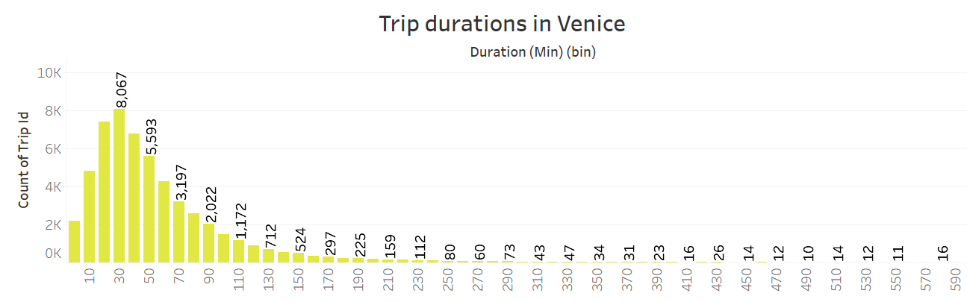
PRICE MODIFICATION
Considered trips in the Venice region for our analysis
Current Tariff:
Fixed rate of $1.75/30 min
Proposed Tariff:
$1 for first 20 min
Subsequent charges should be $1 for every next 10 minutes.
COST BENEFIT ANALYSIS
Net Profit- $3838.25

Slide 19
IN A NUTSHELL
The ARIMA model developed can be used by the company for future forecast of bike requirement for better budgeting, saving unnecessary expenses while procuring new bikes.
The heat map will automatically highlight the routes with maximum traffic and longest distance to guide potential new station locations
$1 Special rides will act as a marketing campaign for the company to attract new customers and compete with rivals offering a similar tariff which will boost ticket sales as well as revenue.
Analysis of characteristics of successful regions and unsuccessful regions provides us with key metrics to identify new regions for further expansion.

Slide 20



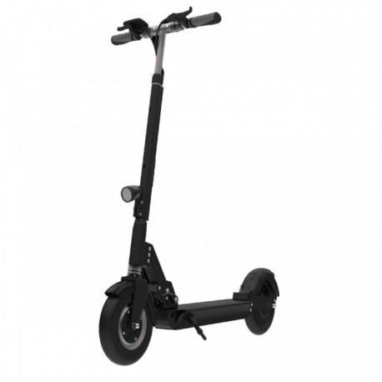
FUTURE OF LA BIKE SHARE
BEST TARIFF PLANS
DOCKLESS BIKES
E- SCOOTERS ON RENT

Slide 21

Thank You

